Slide 1
Welcome!

Slide 2
Happy Birthday December Babies!

Slide 3
Attention Art Committee !!
We will be meeting this Wednesday
during BK den to plan out the family holiday potluck
*If you do not want to be pulled please text on remind by 3pm on Tuesday.

Slide 4
Memory Book!!!
If anyone is interested in designing the B.E.S.T. memory book, then let me know. We can work on the memory book during den or after school.
The memory book is going to be $35. There will be a google order form available on Schoology soon. After filling out the form, don’t forget to pay the fee on school cash online or turn it in to Ms. E (room 176).

Slide 5
Family Holiday Potluck and game night!!
December 13th 6:00-8:30 pm
Get ready for games, food and fun!!
Please bring your BEST dish
Bring family and friends
Wear your ugly sweaters! (contest)
Christmas Movie will be played
Christmas games as well!

Slide 6
LOVE ALL
December 14th
10:30am - 12:00pm
CAMPFIRE SING ALONG (Grace Ministry)
January 18th
6pm - 8:30pm
More Information and Sign-up Genius Link is on the Schoology post soon!

Slide 7
Thank you for decorating the hallway!

Slide 8
Letterman Requirements
Member for a minimum of 2 years
No more than 4 unexcused absences of membership meetings
After 5 excused absences (with 5 school days of notice in advance)
Participate in a minimum of 3 full-time events for both years
Ex. variety show, hayride, prom
B.E.S.T. Friendship match-up for a minimum of 2 years
Help with Fundraising
At least 8 hours of Volunteer Service Hours

Slide 9
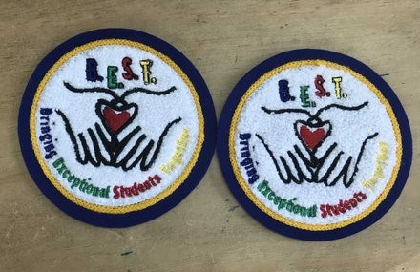
B.E.S.T. patches available!

Slide 10
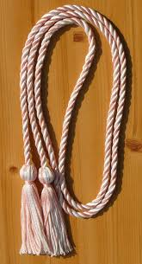
Graduation Cord Requirements
Must be a Senior
No more than 4 unexcused absences of membership meetings
After 5 excused absences (with 5 school days of notice in advance)
Participate in a minimum of 3 full-time events
Ex. variety show, hayride, prom

Slide 11
B.E.S.T. Member Scholarship Eligibility Requirements
Membership: 3 years minimum
Friendship match-ups: 2 years minimum
Service hours
Best membership meeting attendance
Participation in all socials, activities and events
Essay
Possible interview
Interest in a Special Education Major

Slide 12
Questions?
Stay for a game!!!

Slide 13
Game Time - Santa’s Helpers
Grab a piece of paper and write your top 3-5 holiday wish items
Walk around and talk about your lists (do you have the same lists? Do you like something from thiers?)

