Slide 1
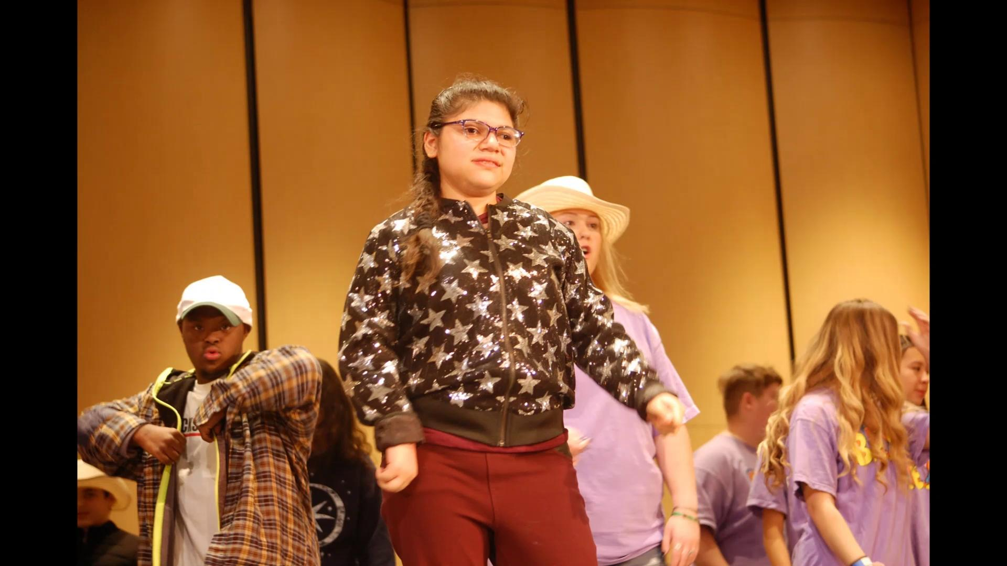

Slide 2
Welcome!

Slide 3
Upcoming
Event ….

Slide 4
More
Upcoming Events!
Family Holiday Potluck- December 13th
Love All Tennis Clinic- December 14th
Invite you B.E.S.T. friend to join you at any or all of these activities

Slide 5
Pictures from the variety show!
If you have any pictures from the variety show, then please email them to hper5650@students.kleinisd.net.

Slide 6
FREINDSHIP FRIDAY
Email Ms.E at cescure1@kleinisd.net
November 22nd in LGI
December 6th & 13th in classrooms

Slide 7
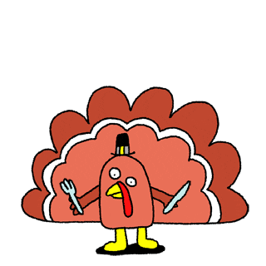
Share a B.E.S.T. experience
Ideas of activites you would like B.E.S.T. to do
Questions?

Slide 8
Join us for some B.E.S.T. Bingo!
Don't forget to sign out with an officer!

