Slide 1
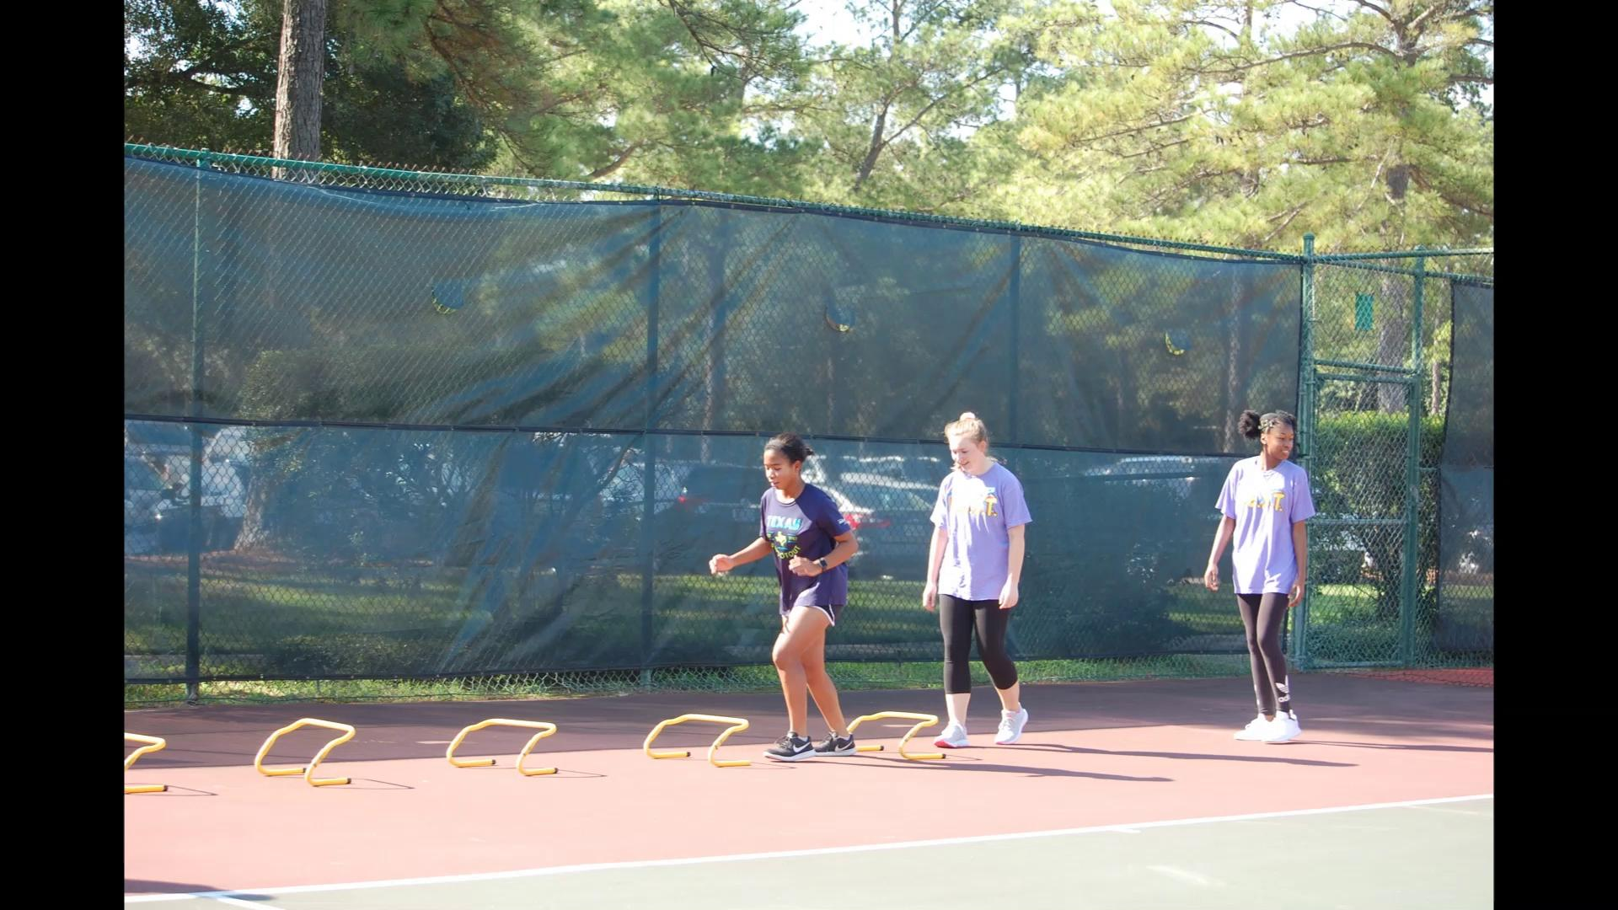
Play video

Slide 2
Welcome!!!

Slide 3
Happy Birthday November Babies!
Notes:
Maddie and Grace need birthday bags

Slide 4
A Word from Your Sponsor
National Vocation Awareness Week
Outstanding member of the month
Notes:
Ms E

Slide 5
Remember, this is our only fundraiser that supports
all of the events, activities and socials we host,
so please INVITE YOUR FRIENDS and FAMILIES

Slide 6
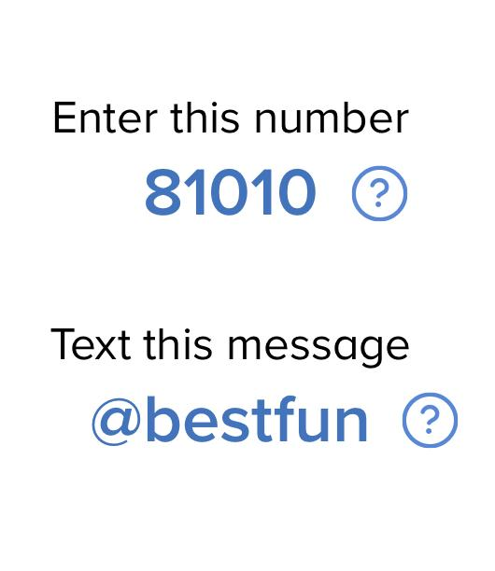
Fundraising Chalenage!
We need your help!
Due to the lack of business sponsors supporting the Variety Show, we are asking every member to help by finding individual sponsors willing to make a small donations of $5, $10 or more.
Every member that brings in a donations, will have their name entered into a drawing, You can drop off donations to Mrs. E in rm # 176.
We really appreciate your help towards making the Variety Show the BEST it can be!

Slide 7
Houston Buddy Walk
This walk promotes Down Syndrome awareness.
November 16th from 9am-3pm
At Sam Houston Race Park!
Limited to 20 people

Slide 8
Grace Ministry’s Paint Night
Love All tennis clinic
Local Service opportunities - earn Service Hours
November 9th, 6:30pm - 8:30pm
12 volunteers needed
More information and Sign-up Genius link is on the Schoology post.
November 16th, 10:30am - 12:00pm
More information and Sign-up Genius link is on the Schoology post.

Slide 9
UPCOMING EVENT…..
MARK YOUR CALENDARS!!!
Family Holiday Potluck and game night
December, 13th 6:00pm - 8:30pm
More information at next meeting

Slide 10
Don’t forget to email Mrs. E about
FRIEND SHIP FRIDAY

Slide 11
QUESTIONS?
Directly after the meeting we will be working on Variety Show rountines and decorations, please stay if you can. :D
Don’t forget to sign out with officers

