Slide 1
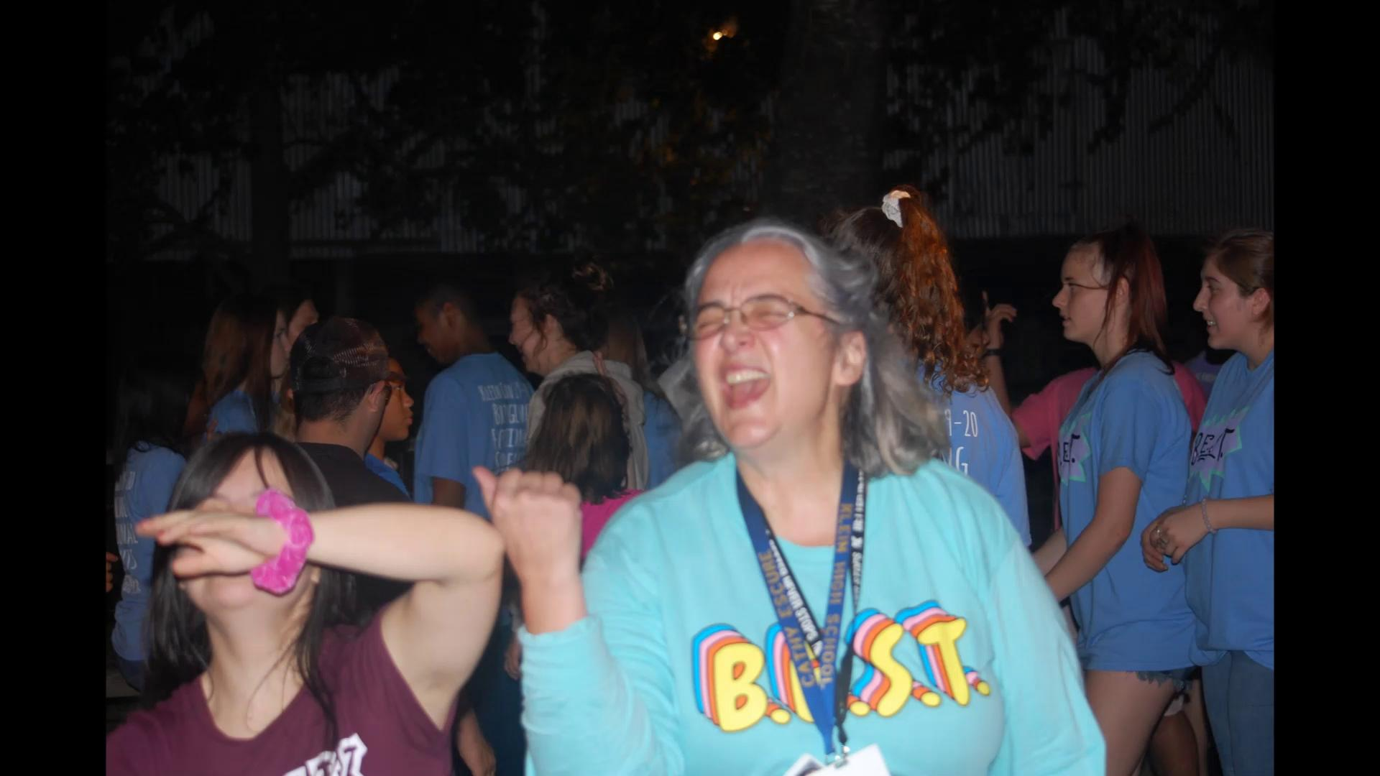

Slide 3
FRIENDSHIP FRIDAY
Email Ms. E at cescure1@kleinisd.net
to be pulled for Friendship Fridays

Slide 4
B.E.S.T. friendship
match ups
Still Needed
Match up meet and greet
will be soon

Slide 5
David
Favorite movies- Spiderman
Favorite food- Candy
Favorite things to do with friends- Walk
Things that describe me- Going to the movies, Playing and watching basketball/ football, icecream, pizza, singing, animals, park, and music

Slide 6
Dominic
What I like to do for fun- Party and go on the playground
Favorite movies- Starwars and Superman
Music- Justin Bieber
Favorite food- Hamburger, pizza, and french fries
Favorite things to do with friends- Go to the zoo, the mall and the movies
Things that describe me- Going to the movies, watching basketball/ football, karate, eating at restaurants, icecream, pizza, singing, baking, animals, outdoor, music, and crafting

Slide 7
Reuben
What I like to do for fun- Draw, play Video games, bowling, and baseball
TV Shows- Anime
Favorite food- Chicken parmesan
Favorite things to do with friends- Playing video, go to the movies, and waching videos
Things that describe me- Artist, going to the movies, eating at restaurants, icecream, pizza, talking on the phone, baking, animals, outdoor, music, and crafting

Slide 8
Jared
What I like to do for fun- go to the museum, and the zoo
Favorite movies- Planet Earth
Favorite food- Banana, apple, pepperoni, and chips
Favorite things to do with friends- Go to McDonalds
Things that describe me- Going to the movies, playing watching basketball and football, karate, eating at restaurants, icecream, pizza, singing, animals, music, and crafting

Slide 9
Wuilmar Rubio
What I like to do for fun - Sing

Slide 10
Camden
What I like to do for fun- Computer time, singing and dancing
Favorite movies- Veggie Tales
Favorite food- Chicken, cheeseburgers and fries, pizza, hot dogs, and spaghetti
Favorite things to do with friends- BBQ, zoo, museum, beach,and mall
Things that describe me- Eating at restaurants, icecream, pizza, singing, baking, animals, and music

Slide 11
Hunter
What I like to do for fun- singing and dancing, enjoys making youtube videos
Favorite movies - Descendants (Disney)
Favorite food- pizza, lasagna, spaghetti
Favorite things to do with friends- watch movies, play games
Things that describe me - Loves superheros, and hanging out with friends

Slide 12
Letterman Requirements
Member for a minimum of 2 years
No more than 4 unexcused absences of membership meetings
After 5 excused absences (with 5 school days of notice in advance)
Participate in a minimum of 3 full-time events for both years
Ex. variety show, hayride, prom
B.E.S.T. Friendship match-up for a minimum of 2 years
Help with Fundraising

Slide 13
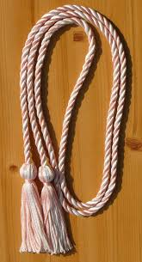
Graduation Cord Requirements
Must be a Senior
No more than 4 unexcused absences of membership meetings
After 5 excused absences (with 5 school days of notice in advance)
Participate in a minimum of 3 full-time events
Ex. variety show, hayride, prom

Slide 14
B.E.S.T. Member Scholarship Eligibility Requirements
Membership: 3 years minimum
Friendship match-ups: 2 years minimum
Service hours
Best membership meeting attendance
Participation in all socials, activities and events
Essay
Possible interview
Interest in a Special Education Major

Slide 15
Art Committee
If you want to be a part of this committee please join the remind.
You will be pulled in den every tuesday until the variety show.
If anyone has any fall or western decoration that you are willing to donate to the variety show

Slide 16
FUNDRAISING
Please pick up a Variety Show sponsorship packet
on your way out!
Items for Variety show silent auction baskets needed!
Items for a pet basket, movie night and game night baskets. Example: gift cards, candy, DVD, pet toys, etc...
We need help delivering sponsorship packets to businesses, if your interested talk with Mrs. E

Slide 17
Variety show
Please come to the biggest event we have this year!! - Variety show!! This show gives students with intellectual and developmental disabilities the opportunity to display their talents.
Volunteer to help with fundraising efforts, decorate, set up and clean up or help our B.E.S.T. friends on stage.
Remember, this is our only fundraiser to help pay for all of the events, activities and socials we host.

Slide 18
Please stay after today’s meeting for some fun social time with some of our B.E.S.T. friends!

Slide 19
Questions???

Slide 21
Notes:
Maddie/ Grace black
First group to line up correctly will get a candy
Groups will line up in order of
Tallest (left) shortest (right)
Oldest left youngest right
Most # of sibling left least # of siblings right
Line up in rainbow order or sirts red (left) purple (right)
Born farthest from klein ( left) closest (right)

