Slide 1
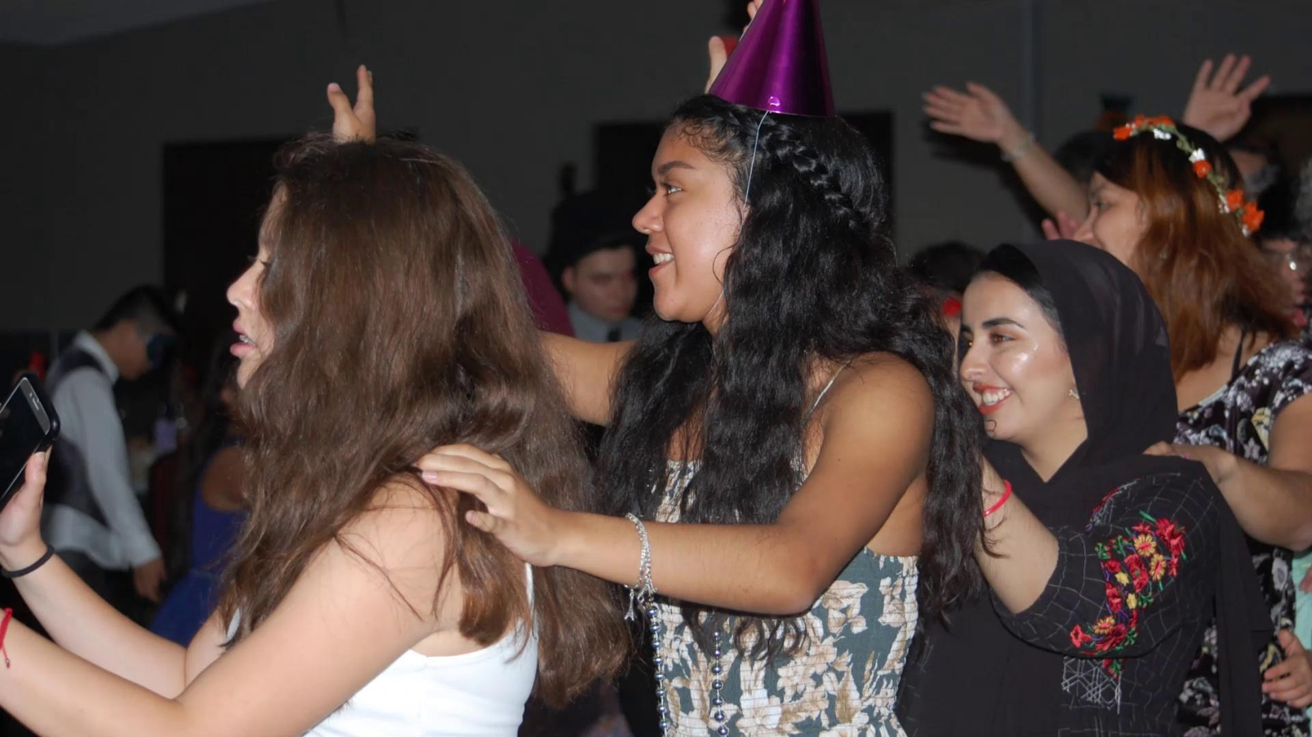

Slide 2
Welcome!
Don't forget to sign out with an officer!

Slide 3
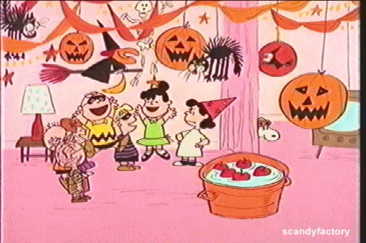
Happy Birthday October Babies!

Slide 4
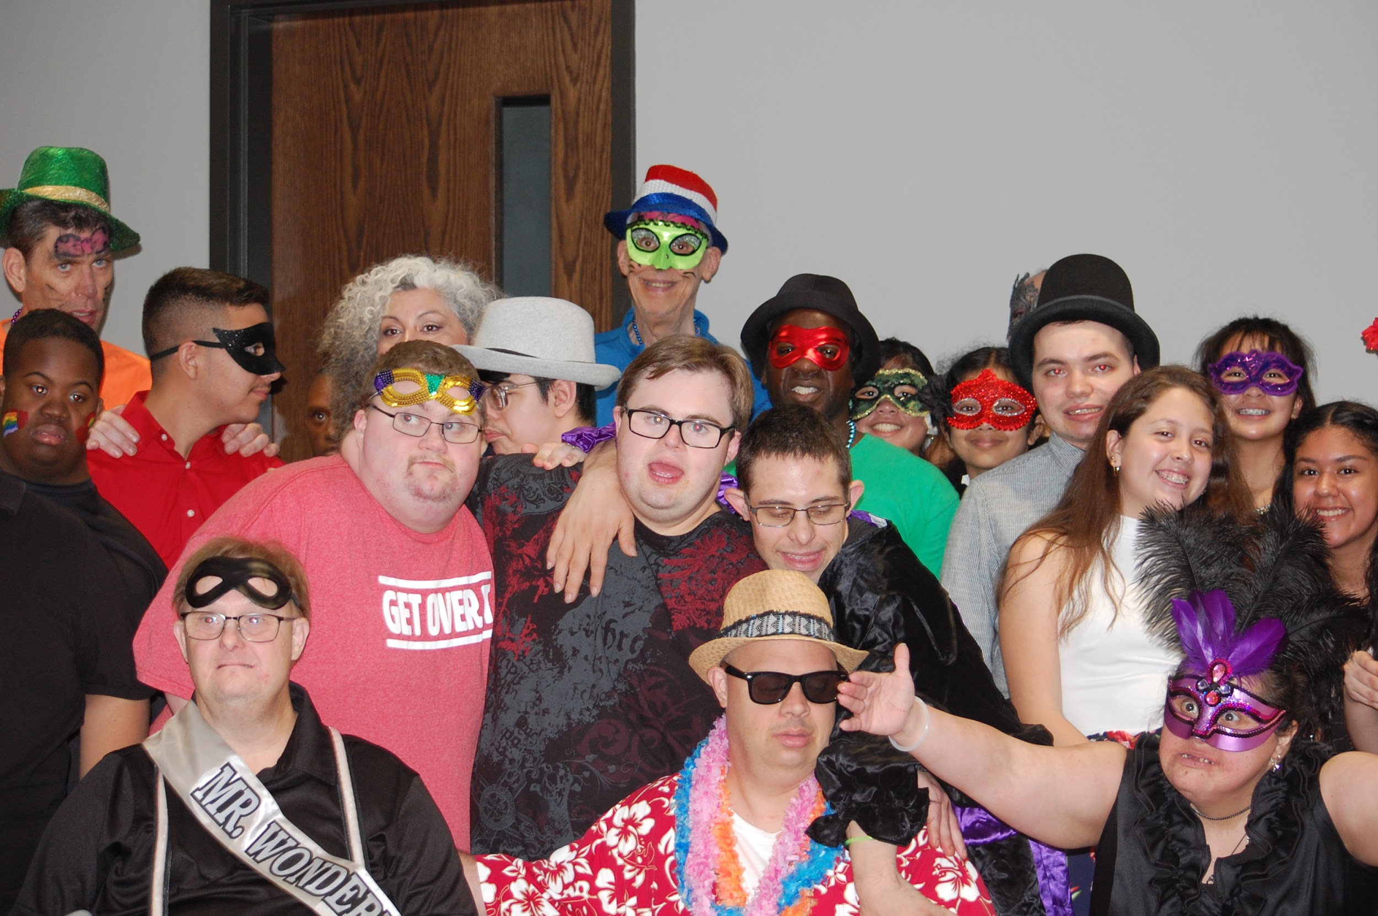
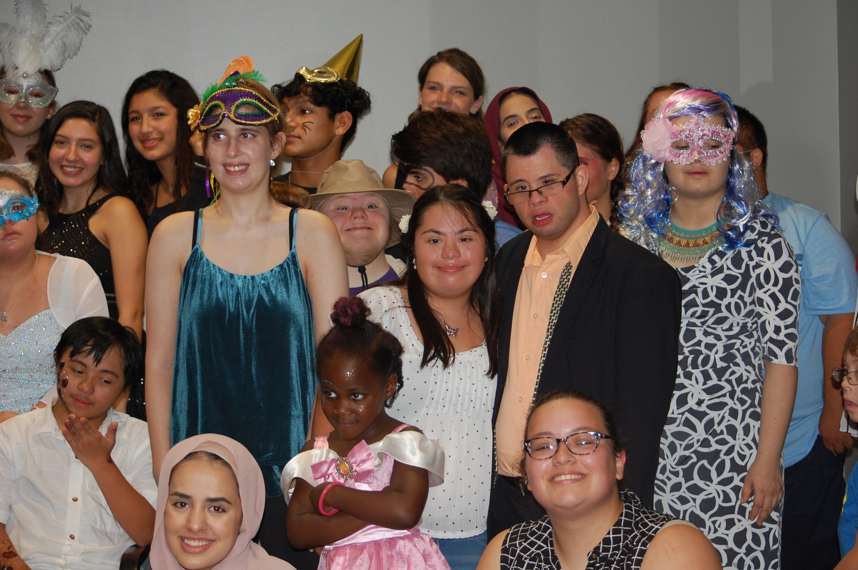
Special thank you to all members who volunteered at the Masquerade dance.
DSAH and Grace Ministry were so impressed by
each and every one of you.
Thank you! Thank you! Thank you!
Notes:
Invite a volunteer to share their experience…..

Slide 5
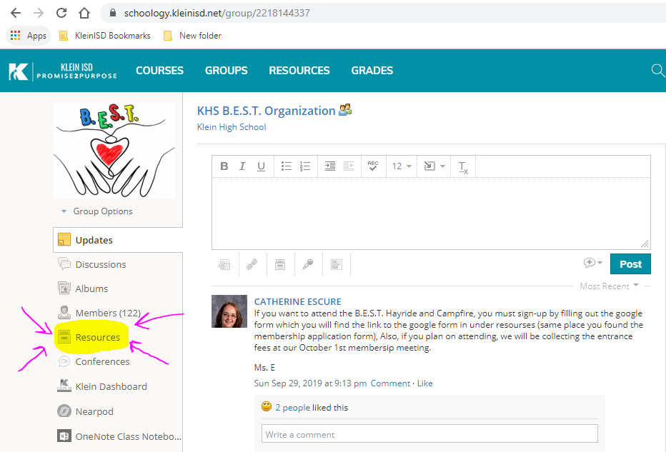
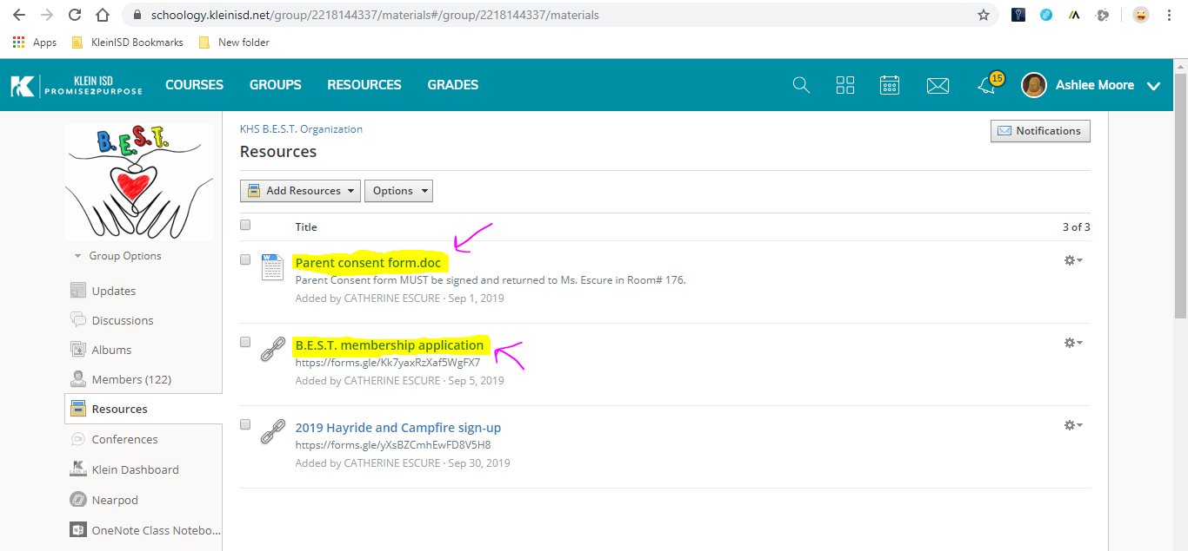
If you have paid but haven’t filled out an application…
Do it now!
Schoology Code: QHGK-FXMW-X842R

Slide 6
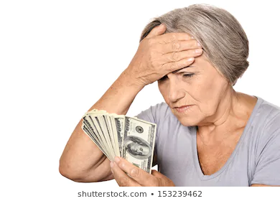
WANTED: Money Owner!
Someone turned in $20 Thursday september 26th & didn't write their name!

Slide 7
Letterman Requirement
At least 2 years
Only 4 unexcused absences of meetings
You are allowed 5 excused (with 5 schools days of notice in advance)
3 full-time events (ex. Variety show, Hayride, BEST Prom)
Helped with Fundraising

Slide 8
Help Needed : FUNDRAISING
Please pick up a Variety Show sponsorship packet on your way out!
Items for Variety show gift baskets wanted!
Ex. Gift cards, candy, etc.
We will be organizing a time to go out and ask local businesses for sponsorships (groups of 3+) so keep an eye out for more information!
We need help sending out emails to businesses for sponsorships so if your interested talk with Mrs. E!

Slide 9
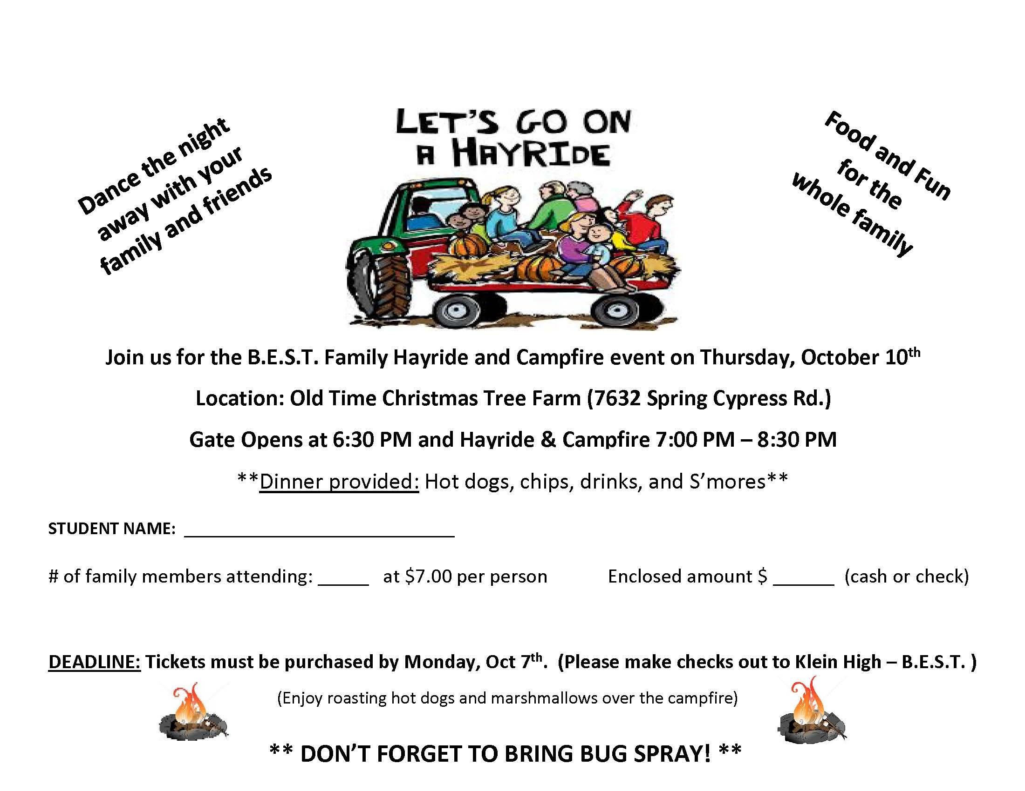
You must sign-up by filling out the google form which you will find the link to the google form in under resources!

Slide 10
Come join us on the following Saturdays:
October 19, November 16th, and December 14th, 11:00am – 12:00 pm
at Northgate Country Club tennis courts
Northgate Country Club is located at: 17110 Northgate Forest Dr, Houston, TX 77068
Remind Access: Text @loveallt to 81010

Slide 11
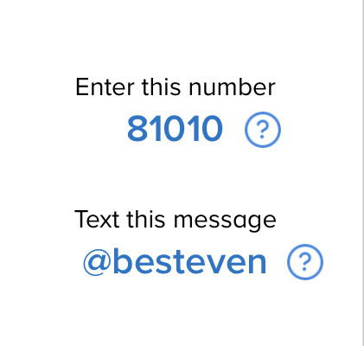
Events and Activities Committee
Join The Events and Activities remind to get information on needed event help, ideas, and Club updates!!!

Slide 12
Social Media
Be sure to check out our social media!
Instagram: bestkleinhigh1
Twitter: BESTkleinhigh1
Website: bestkleinhigh.weebly.com
-if you take any cute pictures at BEST events, please DM us!

Slide 13
The Historical Committee
Join the Historical Committee if you haven’t yet!
We will need help making the memory book.
If you took any pictures last Saturday, then you can email them to hamnapervaiz3@gmail.com.

Slide 14
FRIENDSHIP FRIDAY

Slide 15
Questions?
Don’t forget to sign out with an officer!

